Slide 1

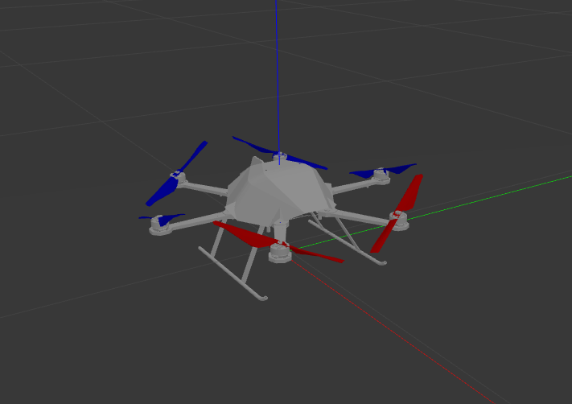
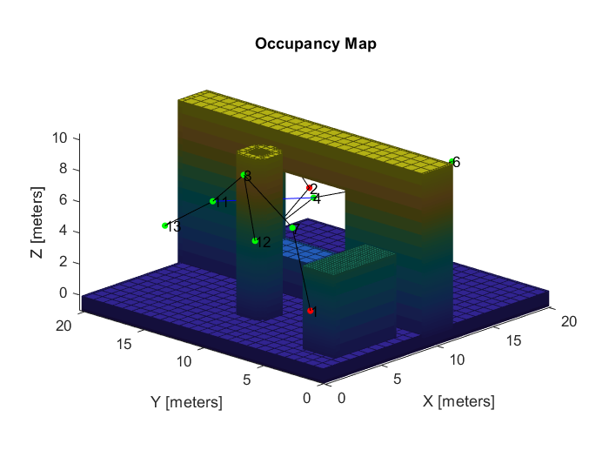
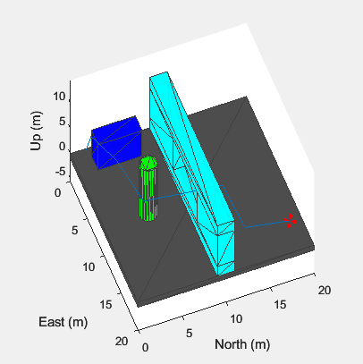
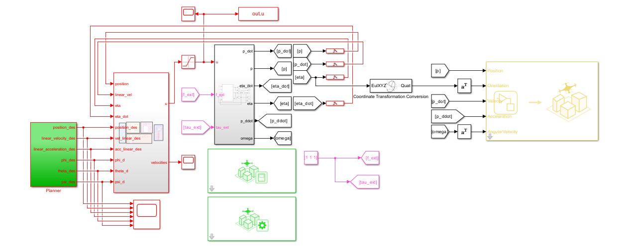
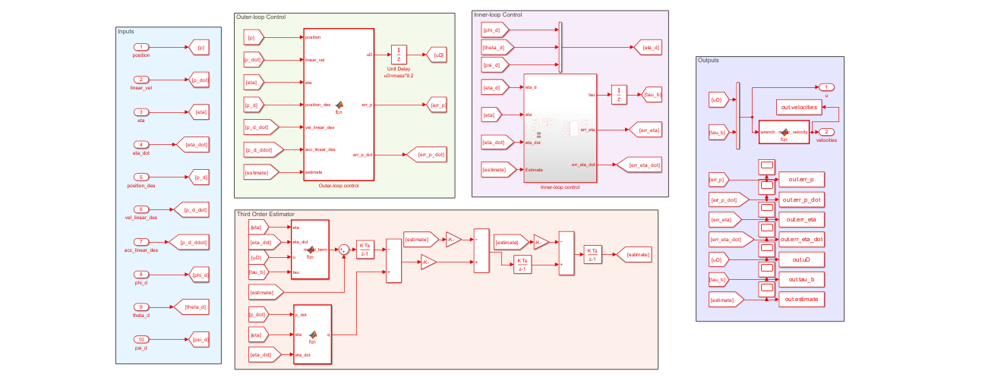
DIPARTIMENTO DI INGEGNERIA ELETTRICA E TECNOLOGIE DELL’INFORMAZIONE
SCUOLA POLITECNICA E DELLE SCIENZE DI BASE
FINAL PROJECT FIELD AND SERVICE ROBOTICS
PLANNING AND CONTROL FOR A FULLY ACTUATED HEXACOPTER
Federico Esposito Prof. P38000142 Fabio Ruggiero
Riccardo Aliotta Academic Year: P38000143 2022/2023

Slide 2

SUMMARY
Description of the Tilted Hexacopter
Allocation matrix
Environment design
Path planning
Trajectory planning
Control problem
RPY and Coordinate-free Estimators
Geometric Control
Hierarchical Control
Passivity-based Control
Feedback Linearization Control
Conclusion
2/33

Slide 3
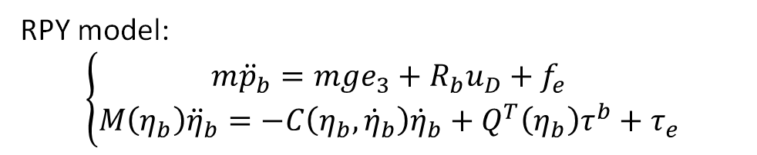
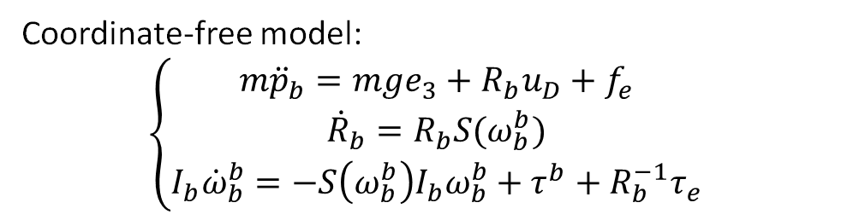
DESCRIPTION OF THE TILTED HEXACOPTER
The robot we have considered is a hexacopter with non coplanar propellers with a cant angle of ±20°.
Thanks to the configuration of its 6 propellers, it is fully actuated.
Coordinate-free model:
$$\left\{\begin{matrix}m{\ddot{p}}_{b}=mge_{3}+R_{b}u_{D}+f_{e} \\ {\dot{R}}_{b}=R_{b}S(ω_{b}^{b}) \\ I_{b}{\dot{ω}}_{b}^{b}=−S\left(ω_{b}^{b}\right)I_{b}ω_{b}^{b}+τ^{b}+R_{b}^{−1}τ_{e}\end{matrix}\right.$$
The 0-th propeller is the red one on the left in the picture; it spins counterclockwise and its cant angle is -20°.
Adjacent propellers have opposite rotation directions and opposite cant angles.
RPY model:
$$\left\{\begin{matrix}m{\ddot{p}}_{b}=mge_{3}+R_{b}u_{D}+f_{e} \\ M\left(η_{b}\right){\ddot{η}}_{b}=−C\left(η_{b}, {\dot{η}}_{b}\right){\dot{η}}_{b}+Q^{T}\left(η_{b}\right)τ^{b}+τ_{e}\end{matrix}\right.$$
3/33

Slide 4
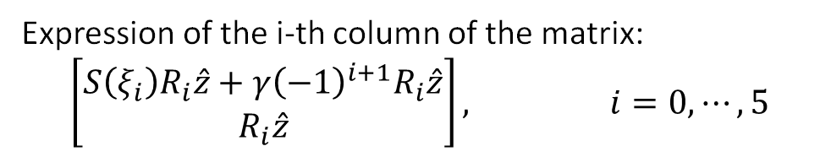
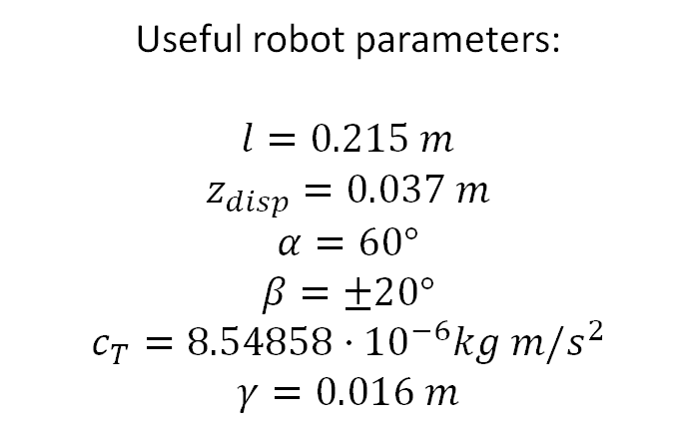
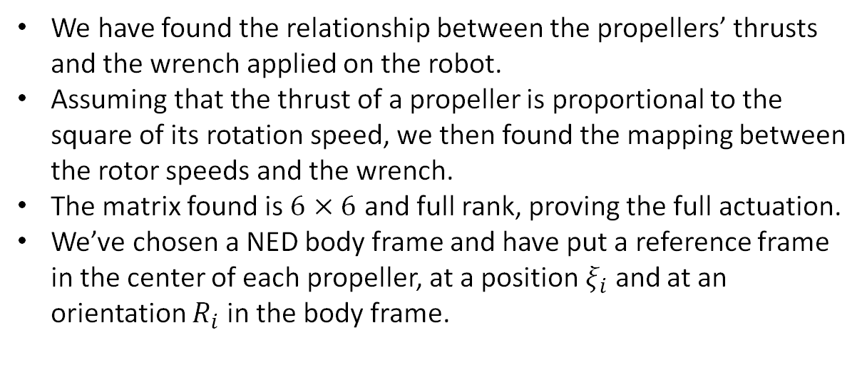
ALLOCATION MATRIX (1)
We have found the relationship between the propellers’ thrusts and the wrench applied on the robot.
Assuming that the thrust of a propeller is proportional to the square of its rotation speed, we then found the mapping between the rotor speeds and the wrench.
The matrix found is $6×6$ and full rank, proving the full actuation.
We’ve chosen a NED body frame and have put a reference frame in the center of each propeller, at a position $ξ_{i}$ and at an orientation $R_{i}$ in the body frame.
Useful robot parameters:
$l=0.215 m$ $z_{disp}=0.037 m$ $α=60°$ $β=±20°$ $c_{T}=8.54858⋅{10}^{−6}kg m/s^{2}$ $$γ=0.016 m$$
Expression of the i-th column of the matrix:
$$\left[\begin{matrix}S\left(ξ_{i}\right)R_{i}\hat{z}+γ{\left(−1\right)}^{i+1}R_{i}\hat{z} \\ R_{i}\hat{z}\end{matrix}\right], i=0, ⋯, 5$$
4/33

Slide 5
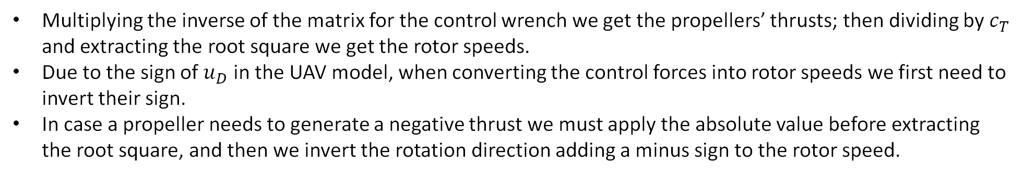
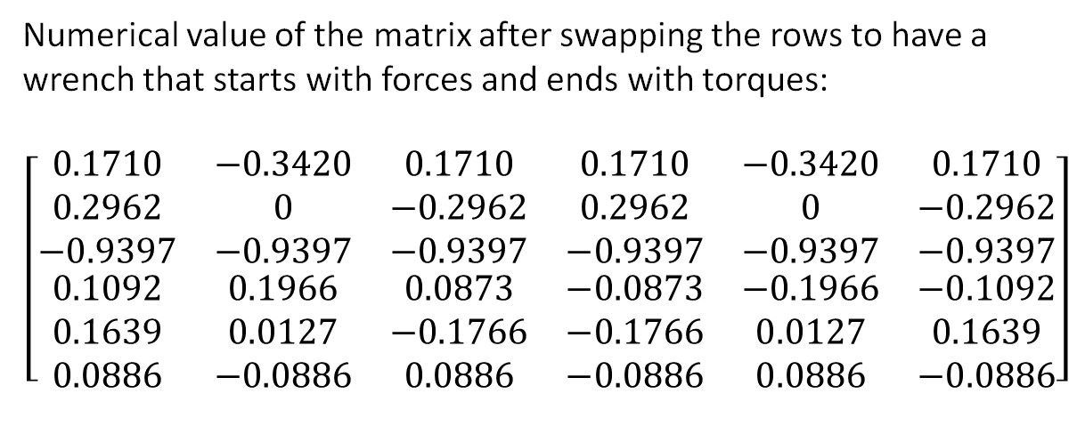
ALLOCATION MATRIX (2)
Numerical value of the matrix after swapping the rows to have a wrench that starts with forces and ends with torques:
$$\left[\begin{matrix}\begin{matrix}\begin{matrix}\begin{matrix}0.1710 \\ 0.2962 \\ −0.9397\end{matrix} \\ \begin{matrix}0.1092 \\ 0.1639 \\ 0.0886\end{matrix}\end{matrix} & \begin{matrix}\begin{matrix}−0.3420 \\ 0 \\ −0.9397\end{matrix} \\ \begin{matrix}0.1966 \\ 0.0127 \\ −0.0886\end{matrix}\end{matrix} & \begin{matrix}\begin{matrix}0.1710 \\ −0.2962 \\ −0.9397\end{matrix} \\ \begin{matrix}0.0873 \\ −0.1766 \\ 0.0886\end{matrix}\end{matrix}\end{matrix} & \begin{matrix}\begin{matrix}\begin{matrix}0.1710 \\ 0.2962 \\ −0.9397\end{matrix} \\ \begin{matrix}−0.0873 \\ −0.1766 \\ −0.0886\end{matrix}\end{matrix} & \begin{matrix}\begin{matrix}−0.3420 \\ 0 \\ −0.9397\end{matrix} \\ \begin{matrix}−0.1966 \\ 0.0127 \\ 0.0886\end{matrix}\end{matrix} & \begin{matrix}\begin{matrix}0.1710 \\ −0.2962 \\ −0.9397\end{matrix} \\ \begin{matrix}−0.1092 \\ 0.1639 \\ −0.0886\end{matrix}\end{matrix}\end{matrix}\end{matrix}\right]$$
Multiplying the inverse of the matrix for the control wrench we get the propellers’ thrusts; then dividing by $c_{T}$ and extracting the root square we get the rotor speeds.
Due to the sign of $u_{D}$ in the UAV model, when converting the control forces into rotor speeds we first need to invert their sign.
In case a propeller needs to generate a negative thrust we must apply the absolute value before extracting the root square, and then we invert the rotation direction adding a minus sign to the rotor speed.
5/33

Slide 6

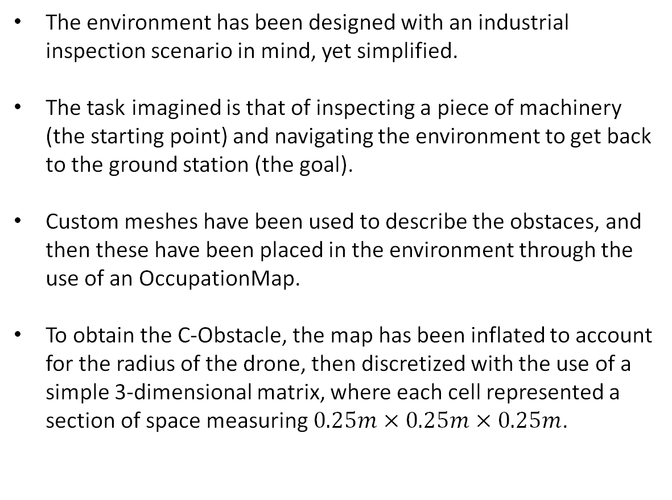
ENVIRONMENT DESIGN
The environment has been designed with an industrial inspection scenario in mind, yet simplified.
The task imagined is that of inspecting a piece of machinery (the starting point) and navigating the environment to get back to the ground station (the goal).
Custom meshes have been used to describe the obstaces, and then these have been placed in the environment through the use of an OccupationMap.
To obtain the C-Obstacle, the map has been inflated to account for the radius of the drone, then discretized with the use of a simple 3-dimensional matrix, where each cell represented a section of space measuring $0.25m×0.25m×0.25m$.
Environment designed for the simulation.
6/33

Slide 7

PATH PLANNING
The path planning algorithm is an extension on three dimensions of the already seen Bilateral RRT algorithm with some minor variations, as both the starting and ending point are considered in the same roadmap for the sake of q_near.
If after a set amount of attempts the two trees can’t be connected, some retries are issued until a connection is found or the maximum total tries are exceeded.
The path is then stored as a matrix made of three columns and as many rows as there are points, and it is passed on to the trajectory planner.
Environment representation with the planned path.
7/33

Slide 8
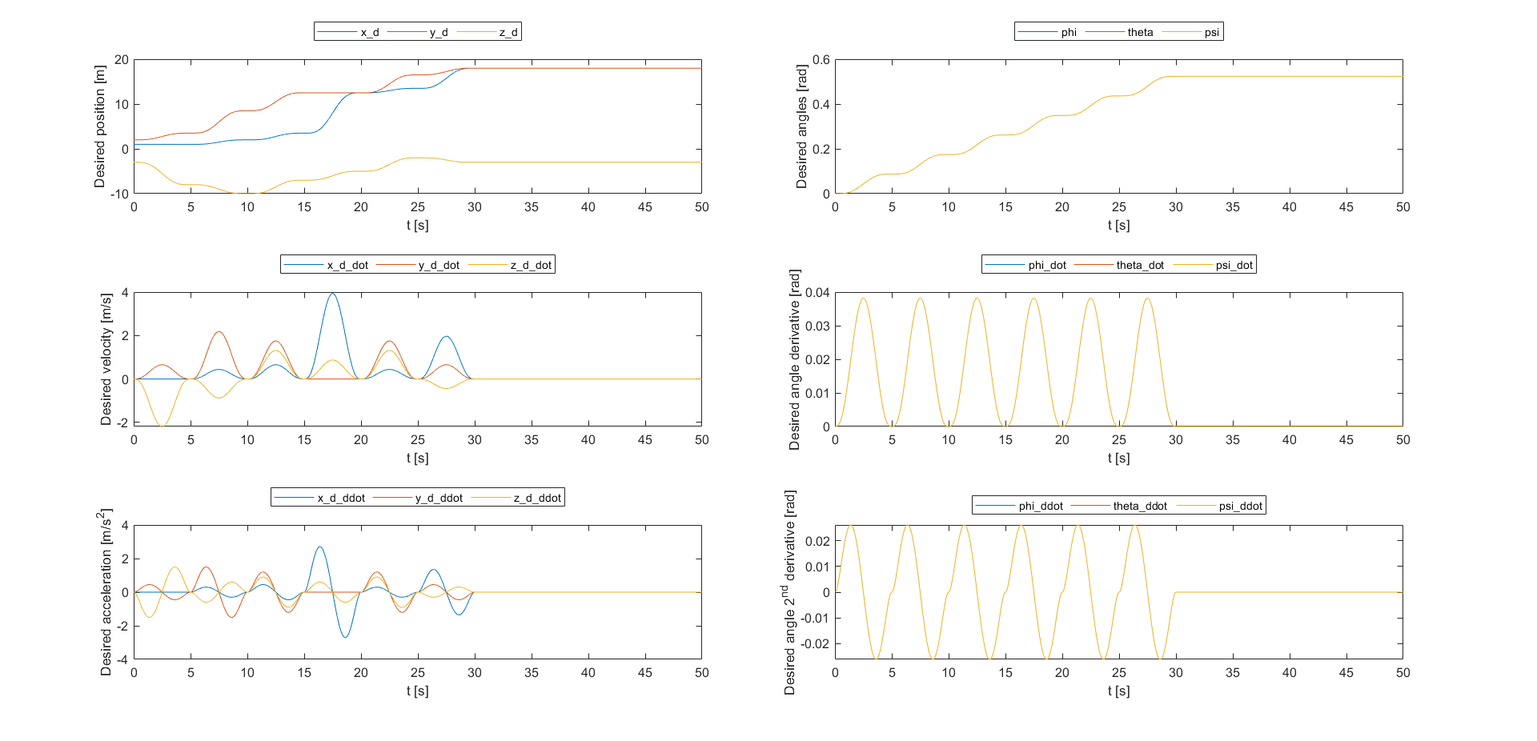
TRAJECTORY PLANNING
The planner is very simple, as it assumes to move the drone from point to point and stopping at every point, while for the orientation the controllable angles (all three RPY angles for the Feedback Linearization Control, only the Yaw for the others) are increased of a fixed amount every step of the way (the simulations were conducted with a 5° increase).
The time law is then obtained by using 5-th order polynomials, in order to have both velocity and acceleration as null in the starting and goal point for every segment of the trajectory.
On the side are the resulting time laws, where the angular variables appear as one as they are equal.
8/33

Slide 9
CONTROL PROBLEM
After defining the trajectory and the time laws, they must be passed as reference to the drone controller. We have designed and tested four different controllers, three of which we’ve seen during the course (Hierarchical, Geometric and Passivity-based) and one designed by us that exploits the tilted drone’s full actuation through a feedback linearization approach.
In order to use the controllers made for the planar multicopter on the tilted we are using, which takes as input forces on all the three axes, we need to pass the computed desired thrust as z-force component, while setting as null the x and y force components.
Where deemed necessary, additional integral actions have been added to the scheme for robustness and for error convergence, while the output wrench has been saturated. Moreover, for every controller an estimator has been designed, implemented and integrated in the control loop. Different controls, however, could be based on different model descriptions, and so also the estimator needs to vary accordingly.
9/33

Slide 10
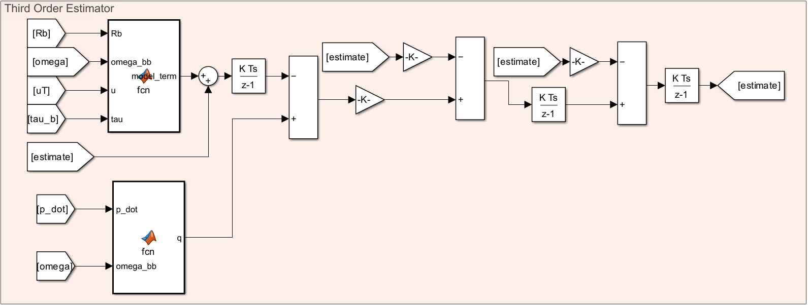
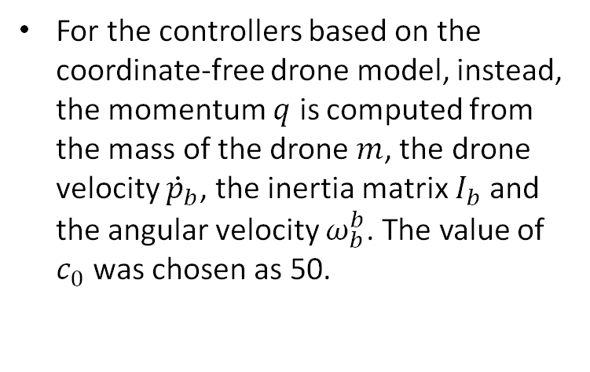
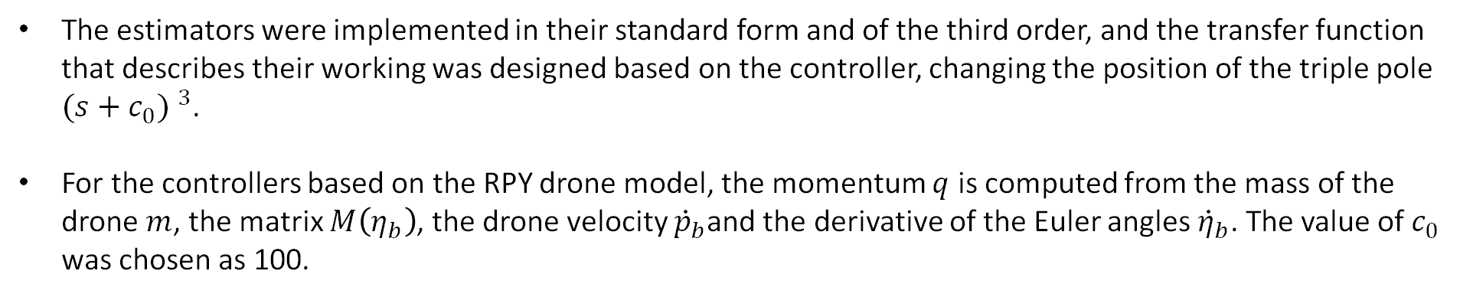
RPY AND COORDINATE-FREE ESTIMATORS
The estimators were implemented in their standard form and of the third order, and the transfer function that describes their working was designed based on the controller, changing the position of the triple pole ${(s+c_{0}) }^{3}$.
For the controllers based on the RPY drone model, the momentum $q$ is computed from the mass of the drone $m$, the matrix $M\left(η_{b}\right)$, the drone velocity ${\dot{p}}_{b}$and the derivative of the Euler angles ${\dot{η}}_{b}$. The value of $c_{0}$ was chosen as 100.
For the controllers based on the coordinate-free drone model, instead, the momentum $q$ is computed from the mass of the drone $m$, the drone velocity ${\dot{p}}_{b}$, the inertia matrix $I_{b}$ and the angular velocity $ω_{b}^{b}$. The value of $c_{0}$ was chosen as 50.
10/33

Slide 11
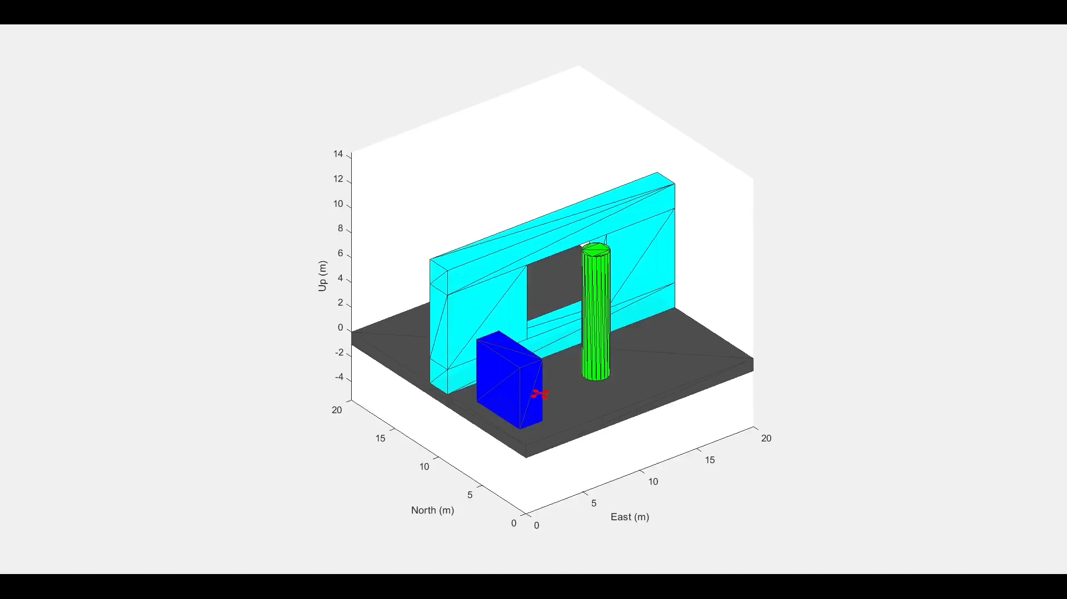
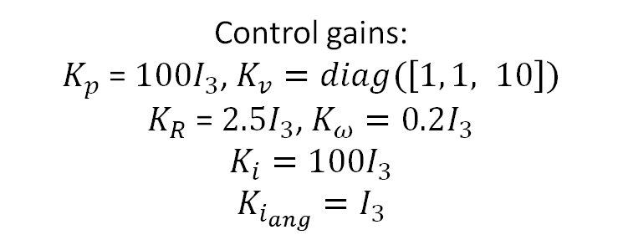
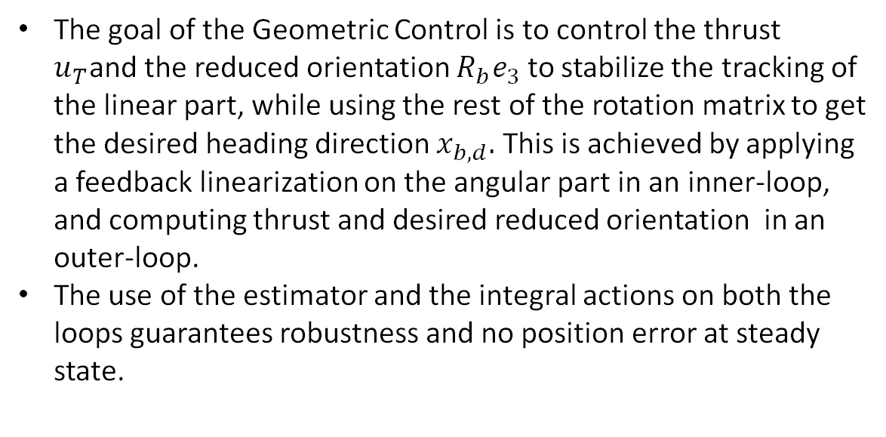
GEOMETRIC CONTROL
The goal of the Geometric Control is to control the thrust $u_{T}$and the reduced orientation $R_{b}e_{3}$ to stabilize the tracking of the linear part, while using the rest of the rotation matrix to get the desired heading direction $x_{b,d}.$ This is achieved by applying a feedback linearization on the angular part in an inner-loop, and computing thrust and desired reduced orientation in an outer-loop.
The use of the estimator and the integral actions on both the loops guarantees robustness and no position error at steady state.
Control gains:
$K_{p}$ = $100I_{3}$, $K_{v}=diag(\left[1, 1, 10\right])$
$K_{R}$ = $2.5I_{3}$, $K_{ω}=0.2I_{3}$
$$K_{i}=100I_{3}$$
$$K_{i_{ang}}=I_{3}$$
11/33

Slide 12
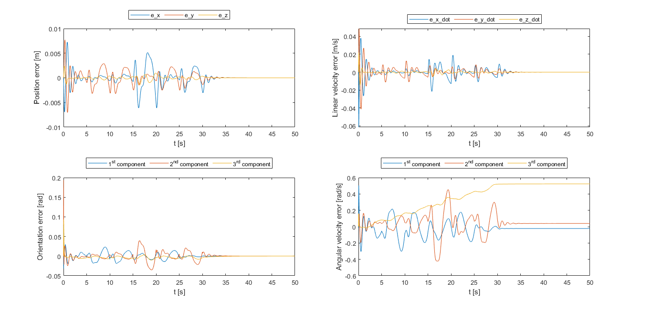
GEOMETRIC CONTROL (CONTROL ERRORS)
12/33

Slide 13
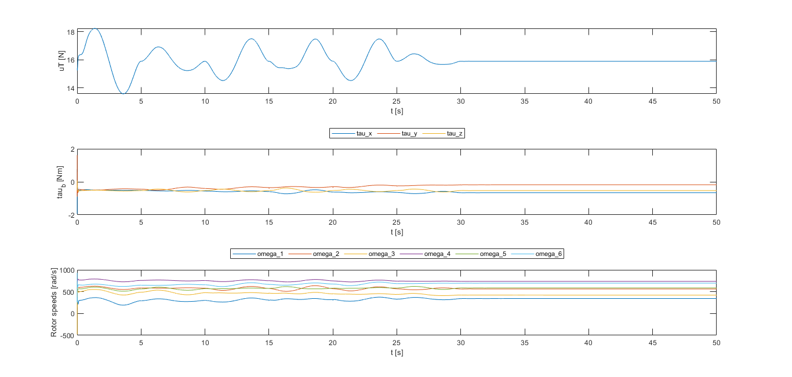
GEOMETRIC CONTROL (CONTROL INPUTS)
13/33

Slide 14
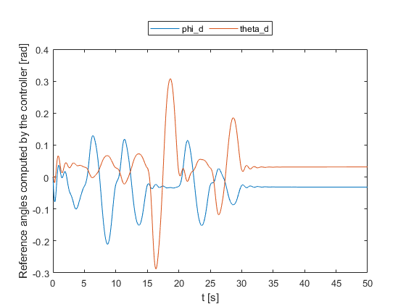
GEOMETRIC CONTROL (REFERENCE ANGLES)
14/33

Slide 15
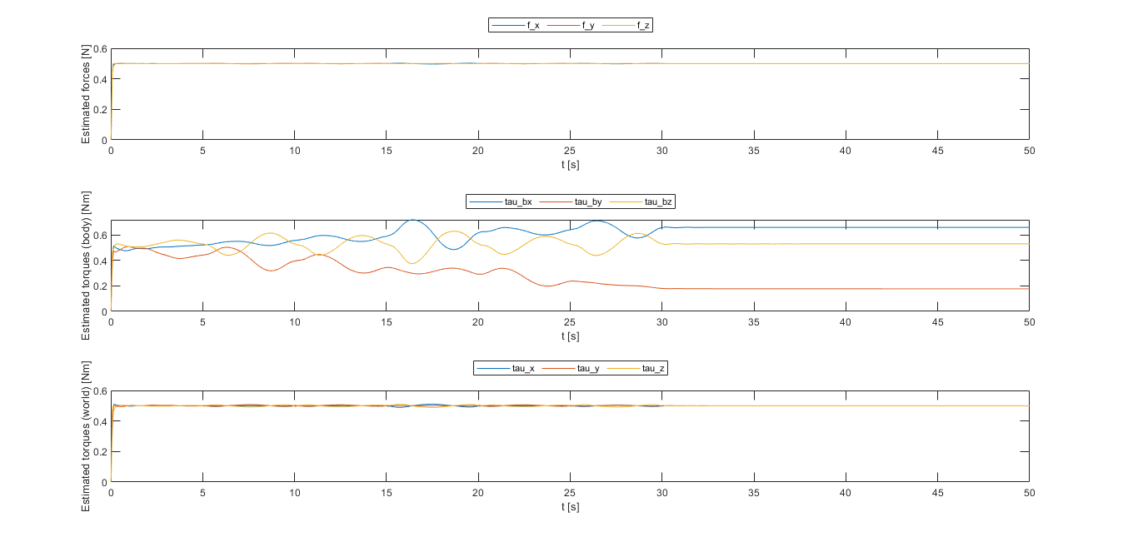
GEOMETRIC CONTROL (ESTIMATES)
15/33

Slide 16

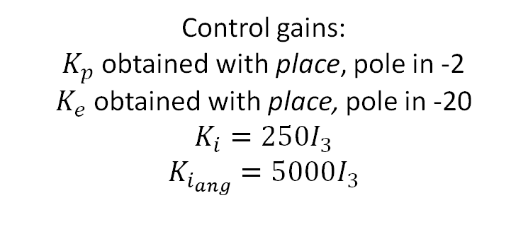
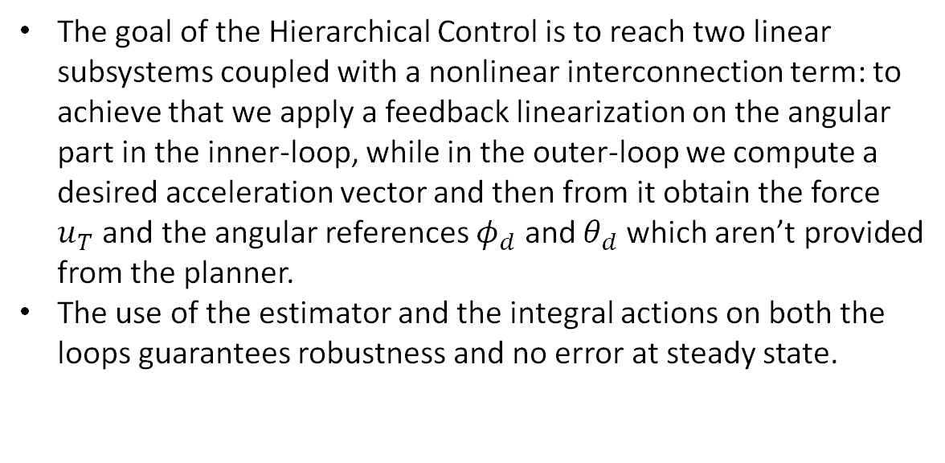
HIERARCHICAL CONTROL
The goal of the Hierarchical Control is to reach two linear subsystems coupled with a nonlinear interconnection term: to achieve that we apply a feedback linearization on the angular part in the inner-loop, while in the outer-loop we compute a desired acceleration vector and then from it obtain the force $u_{T}$ and the angular references $φ_{d}$ and $θ_{d}$ which aren’t provided from the planner.
The use of the estimator and the integral actions on both the loops guarantees robustness and no error at steady state.
Control gains:
$K_{p}$ obtained with place, pole in -2
$K_{e}$ obtained with place, pole in -20
$$K_{i}=250I_{3}$$
$$K_{i_{ang}}=5000I_{3}$$
16/33

Slide 17
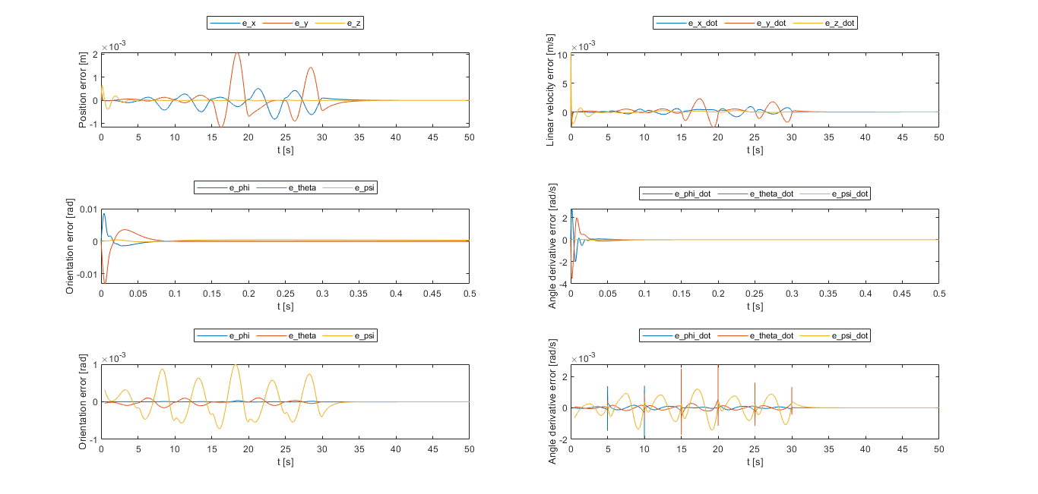
HIERARCHICAL CONTROL (CONTROL ERRORS)
17/33

Slide 18
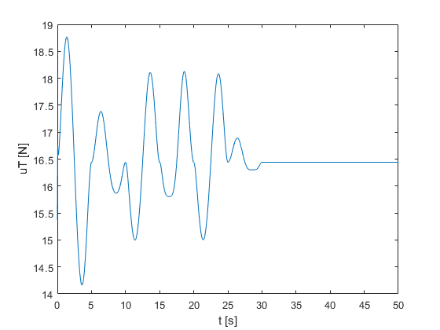
HIERARCHICAL CONTROL (CONTROL INPUTS 1)
18/33

Slide 19
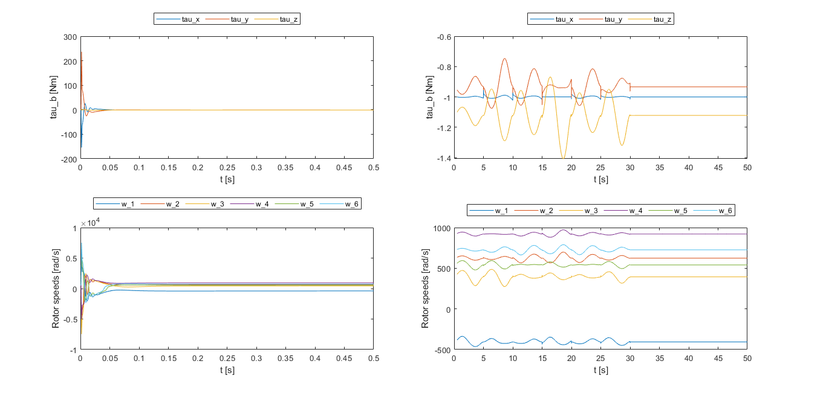
HIERARCHICAL CONTROL (CONTROL INPUTS 2)
19/33

Slide 20
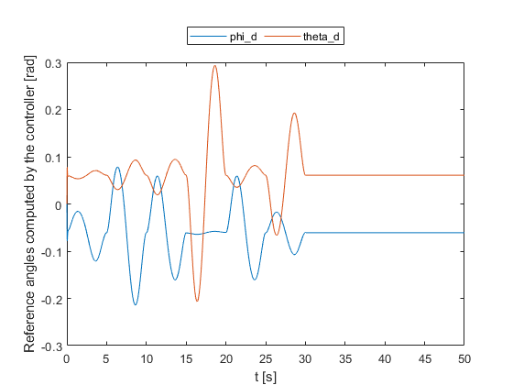
HIERARCHICAL CONTROL (REFERENCE ANGLES)
20/33

Slide 21
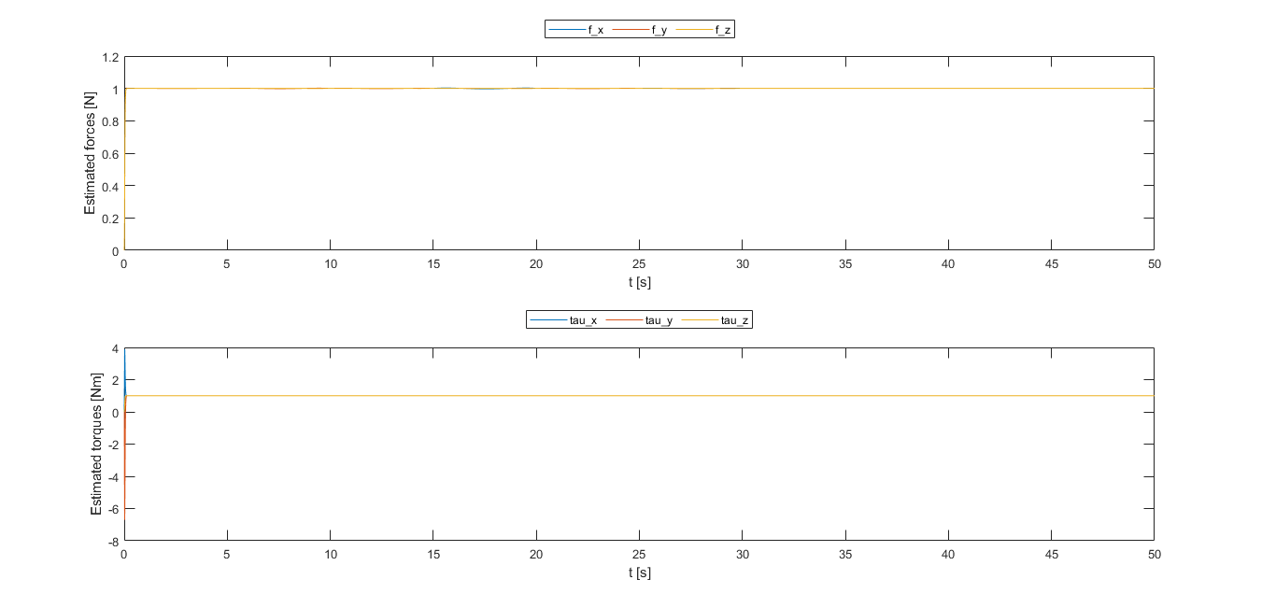
HIERARCHICAL CONTROL (ESTIMATE)
21/33

Slide 22


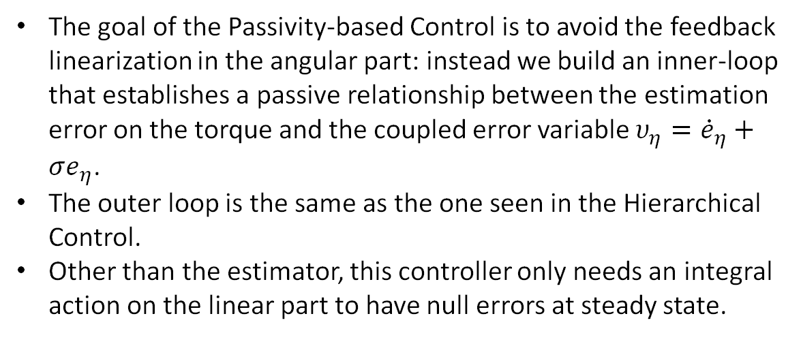
PASSIVITY-BASED CONTROL
The goal of the Passivity-based Control is to avoid the feedback linearization in the angular part: instead we build an inner-loop that establishes a passive relationship between the estimation error on the torque and the coupled error variable $υ_{η}={\dot{e}}_{η}+σe_{η}$.
The outer loop is the same as the one seen in the Hierarchical Control.
Other than the estimator, this controller only needs an integral action on the linear part to have null errors at steady state.
Control gains:
$$σ=10$$
$$ν=10$$
$$D_{0}=10I_{3}$$
$$K_{0}=σD_{0}=100I_{3}$$
22/33

Slide 23
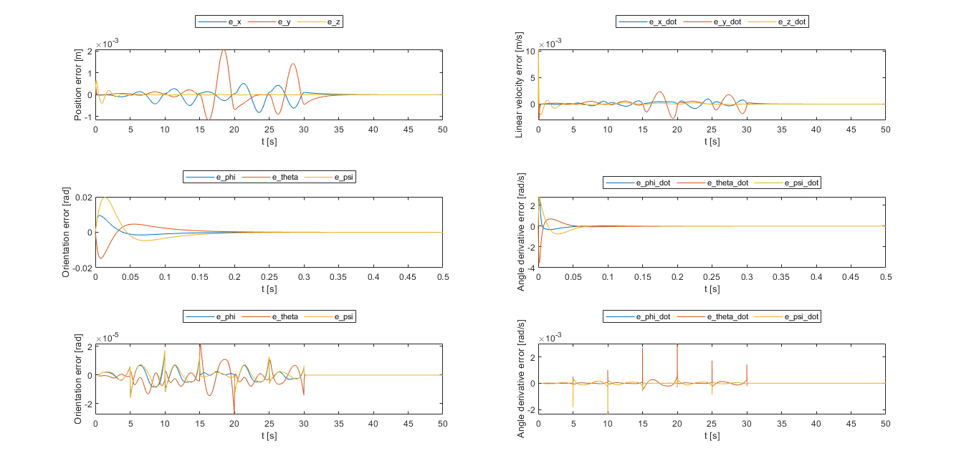
PASSIVITY-BASED CONTROL (CONTROL ERRORS)
23/33

Slide 24

PASSIVITY-BASED CONTROL (CONTROL INPUTS 1)
24/33

Slide 25
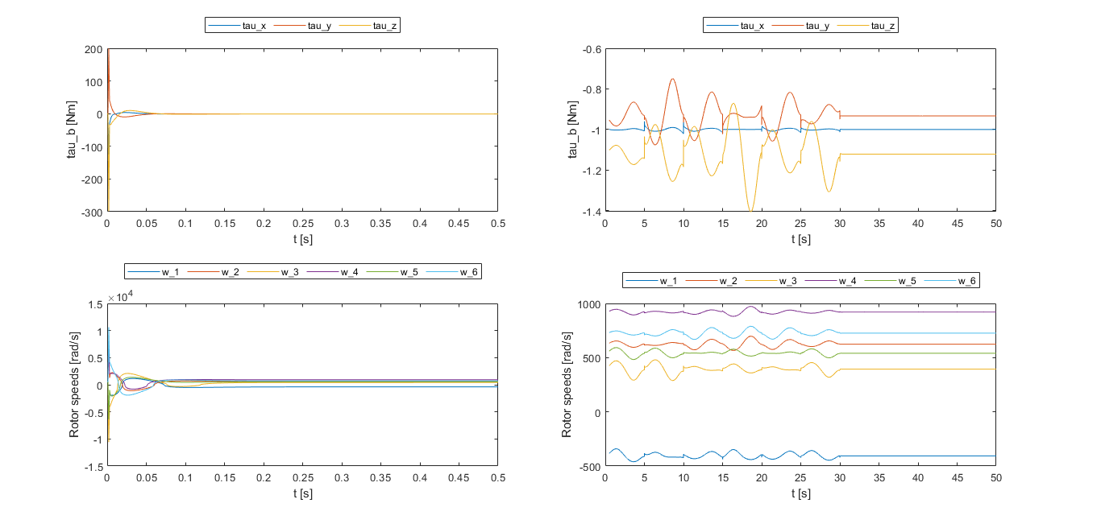
PASSIVITY-BASED CONTROL (CONTROL INPUTS 2)
25/33

Slide 26

PASSIVITY-BASED CONTROL (REFERENCE ANGLES)
26/33

Slide 27
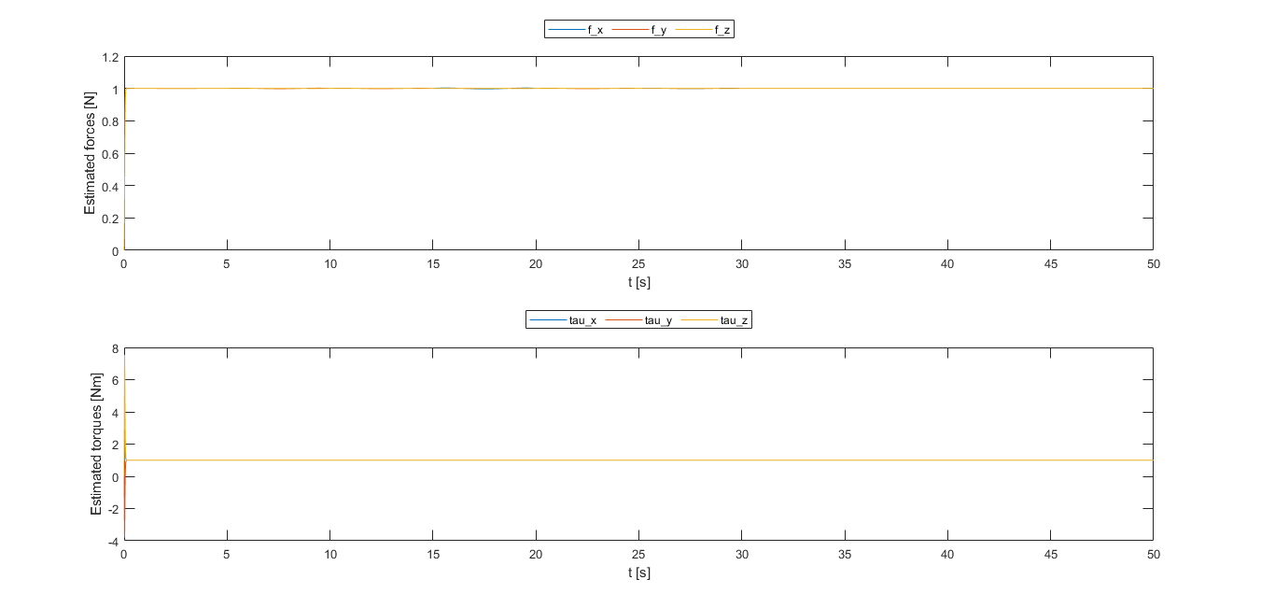
PASSIVITY-BASED CONTROL (ESTIMATE)
27/33

Slide 28

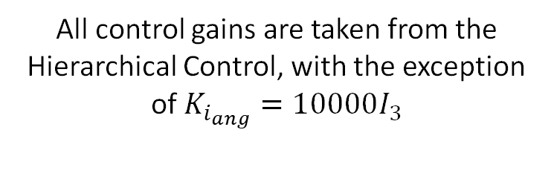
FEEDBACK LINEARIZATION CONTROL
With the Feedback Linearization Control we can finally exploit the tilted drone’s full actuation and thus use the full wrench as a control input.
The inner-loop is the same as the Hierarchical Control, while for the outer loop we simply cancel the system’s dynamics and then apply a virtual control input.
This time the integral action has been applied only to the angular part; both loops make use of the estimator.
All control gains are taken from the Hierarchical Control, with the exception of $K_{i_{ang}}=10000I_{3}$
28/33

Slide 29
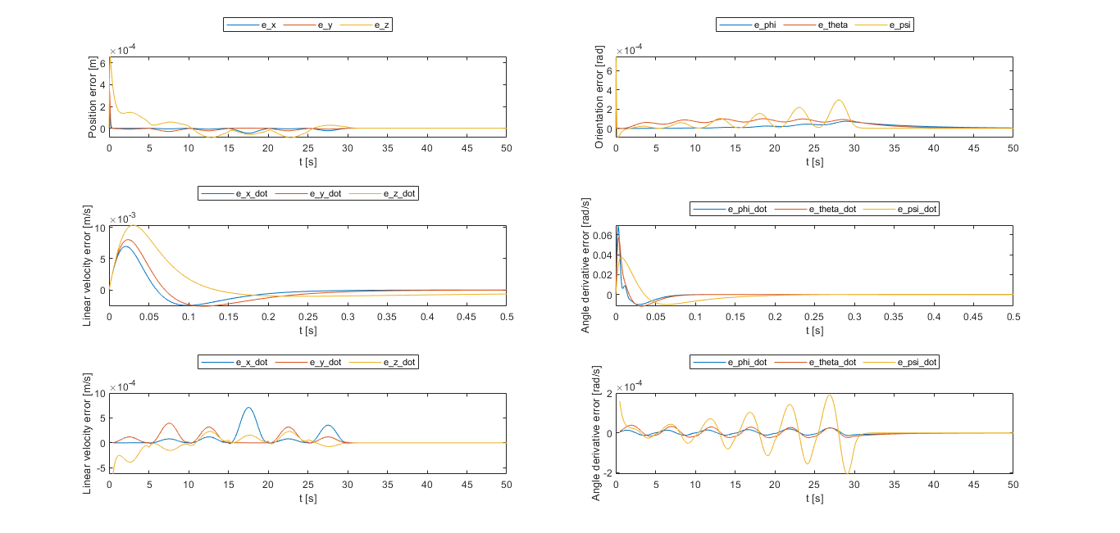
FEEDBACK LINEARIZATION CONTROL (CONTROL ERRORS)
29/33

Slide 30
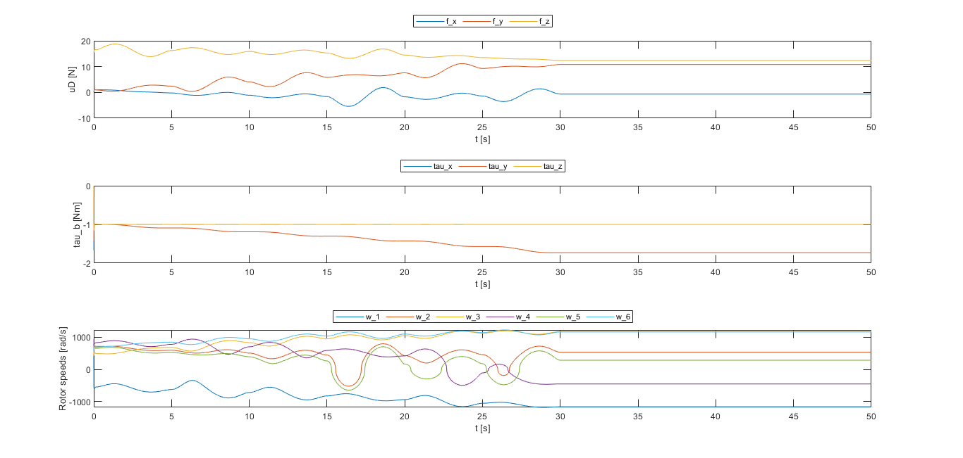
FEEDBACK LINEARIZATION CONTROL (CONTROL INPUTS)
30/33

Slide 31
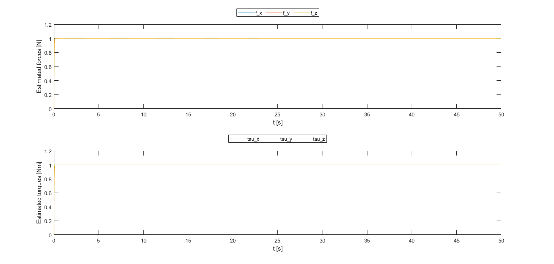
FEEDBACK LINEARIZATION CONTROL (ESTIMATE)
31/33

Slide 32
CONCLUSIONS
We can conclude that all controllers performed in a more than satisfactory way, but the Geometric Control has many robustness issues. Moreover, for the intended scope of the drone’s tasks, there is no need for acrobatic flight, and for these reasons the use of this controller is not preferrable.
Among the RPY controllers, while the performances are all more than acceptable, the Feedback Linearization Controller has the best overall performances, with similar errors to the other controllers and with estimates and control inputs free of overshoot. Moreover, the full actuation of the drone itself and the exploitation of this by the controller makes it also much more dexterous if compared to the other ones. For these reasons, the preferrable choice for a physical implementation of this kind of drone (among the analyzed controllers) should be the FBL.
Through the already computed rotor velocities we could also directly command a simulated (or real, for this matter) drone without too much code conversion effort thanks to MATLAB’s integrated code generation.
32/33

Slide 33
THANKS FOR THE ATTENTION
33/33

